Slide 1
HISTORY OF COMPUTERS
0784418863/0753109061
michaelmulongo992@gmail.com

Slide 2
Computers
A computer is an electronic machine that accepts input, processes it, produces output and stores information.
What do computers do? (IPO – Input-Process-Output)
Accepts data as raw facts such as figures, numbers, letters and symbols.
Processes data into information (processed data).
Produces output.
Stores results.

Slide 3
Characteristics of a computer
Speed: A powerful computer is capable of performing about 3-4 million simple instructions per second.
Automatic: Once activated, very minimum human being intervention, Given a job, computer can work on it automatically without human interventions
Accuracy: free from errors, In addition to being fast, computers are also accurate. Errors that may occur can almost always be attributed to human error (inaccurate data, poorly designed system or faulty instructions/programs written by the programmer).
Diligence: Ability to repeat the same activity at the same speed and accuracy. Computer is free of tiredness, it can continuously for hours without creating any error.

Slide 4
Cont’d
Versatility: able to adapt or to be adopted to different functions or activities, Computer is capable of performing almost any task if the task can be reduced to a finite series of logical steps
Power of Remembering: Computer can store and recall any amount of information because of its secondary storage capability. It forgets or loses certain information only when it asked to do so
No Feelings: Computers are devoid of emotions. Their judgement is based on the instructions given to them in form of programs that are written by us (human Beings)
Storage-bulky data and information can be storage in very small devices.
Electronic-very minimum number of moving parts of the computer system.

Slide 5
Data and Information
Data is a collection of raw facts. Data can be processed to produce useful information. Data does not have meaning and it can not be used for decision making.
Information is processed data. For example data collected from census. It has meaning and can be used for decision making.

Slide 6
Data and Information
Example of data
Johnson, Salome, 34, 20, Mary 178, 100, Sabrina, 4,5,189,151.
Example of Information
NAME | AGE | HEIGHT
Johnson | 4 | 20
Salome | 34 | 178
Mary | 20 | 189
Sabrina | 5 | 100

Slide 7
Differences between data and information
DATA | INFORMATION
Is a collection of facts, figures and statistics related to an object. | Is processed data
Is not used in decision making | Is used in decision making
Data has no meaning | Information has meaning.

Slide 8
Data processing Cycle
Data Processing Cycle is the set of operations used to transform data into useful information. The main purpose of this is to create actionable information that can be used to enhance a business. This is because data in raw form is not useful to the organization.
Steps in data processing cycle
Data collection
Data input
Data processing
Data output
Data storage

Slide 9
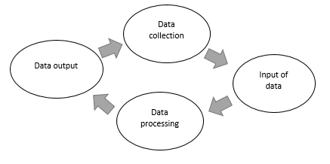
Steps in data processing cycle
Collection. Here, the raw data is gathered from defined and accurate sources so that the subsequent findings are valid and usable.
Preparation. This is the process of sorting and filtering the raw data to remove unnecessary and inaccurate data. Here, raw data is checked for errors, duplication, miscalculations or missing data and transformed into a suitable form for further analysis and processing.

Slide 10
Steps in data processing cycle
Input. In this step, the raw data is converted into machine readable form and fed into the processing unit.
Data Processing. Here, raw data is subjected to various data processing methods using machine learning and artificial intelligence algorithms to produce desired output.
Output. The data is finally transmitted and displayed to the user in a readable form like graphs, tables, vector files, audio, video, documents etc. This output can be stored and further processed in the next data processing cycle.
Storage. This is where data and metadata are stored for further use. This allows for quick access and retrieval of information whenever needed and also allows it to be used as input in the next data processing cycle directly.

Slide 11
Methods of data processing
Manual data processing.
This is a method where data processing is handled manually. All the processes are done with human intervention and without the use of any other electronic device or automation software. It is cheap, requires little or no tools but produces high errors, high labor costs and lots of time.
Mechanical data processing.
This method involves processing data mechanically through use of machines and devices. These are: calculators, typewriters, etc. It produces less errors
Electronic data processing
Here, data is processed with modern technologies using data processing software and programs. A set of instructions is given to the software to process the data and yield output. This method is expensive but provides the fastest processing speeds with the highest reliability and accuracy of output.

Slide 12
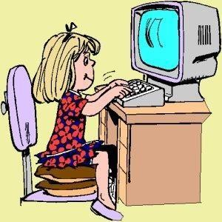
Uses of computer
Playing games
Watching videos
Listening to music
Internet browsing
Communication
Study purposes

Slide 13
Computer literacy
Computer literacy means understanding of what a computer is and how it can be used as a resource.
A computer literate is a person having sufficient knowledge and skill to be able to use computers.
A computer literate is aware, knowledgeable and able to interact with the computer.

Slide 14

Development of computers
The first instrument that is known in the history of computers was called Abacus.
Abacus:
The literal meaning of Abacus is board or calculating table. Sometimes around 750 BC The Egyptians made this table of rectangular frame with rods & a divider as shown below.
The rods were having beads of different colors for counting.
Hindus in India made the similar structure on sand & Greeks made it on the stones or slabs.
The Chinese later perfected the Abacus. There were total 10 columns.
Moving the beads sideways-performed addition or subtraction. The place value of the digits of the numbers & position of beads helped in calculation process.

Slide 15
Pascal’s adding Machine:
Pascal’s adding Machine: (1642 A.D.) A French mathematician Blaise Pascal invented a machine in 1642 for adding numbers.
The characteristic of addition was the speed with which it was done.
So the machine was named as adding machine. For addition & subtraction it worked on clockwork mechanism principle.
The adding machine consisted of numbered toothed wheels.
Each tooth was having a unique position value.
The rotation of wheels controlled the addition & subtraction operations.
Carry-transfer was also done automatically in this.

Slide 16
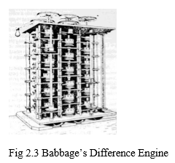
Babbage’s Difference Engine
Babbage’s Difference Engine (1822 AD): An English Professor of Mathematics Charles Babbage developed a Mechanical machine with the name Difference Engine.
The machine was able to calculate various mathematical functions like logarithms, polynomials & algebraic.
The precision in calculating these functions was quite good. It was giving the results up to 20 decimal places.

Slide 17
Babbage’s Analytical Engine
Babbage’s Analytical Engine (1833 AD): This was the machine that never became operational. But the idea & design of the machine given by Charles Babbage has some of the concepts being used in modern day computers. For this reason He is also called the Father of Computers.
The meticulous & methodical design of the Analytical engine has the capability to perform comparisons.
The features like Central processor, storage area, memory & input-output devices were incorporated in the design. It also has the capability to follow some machine sequences.

Slide 18
Babbage’s Analytical Engine cont’d
The most fascinating of all was the permission to change the numbers & instructions already stored in the machine.
The programs were to be stored in punched cards to be read by the machine. Lady Augusta Ada Lovelace helped Babbage in organizing the programs into the analytical machine concept. So she is also called as the First Programmer.

Slide 19
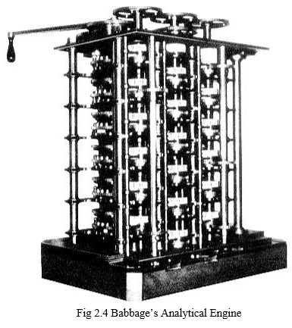
Babbage’s Analytical Engine

Slide 20
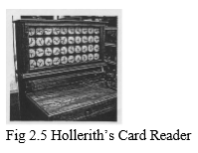
Herman Hollerith’s Card Reader
Herman Hollerith’s Card Reader (1877 AD): An American Statistician Herman Hollerith, working in the department of Census fabricated the dream of Charles Babbage.
He was annoyed at the time taken to calculate & organize the data of a census. It generally took around 10 years to calculate the data by which time the next census became due.
By his efforts he developed the machine & used it for census data calculations. The data was now calculated in three years instead of 10 years. He used punched cards for input, output & instructions.
Hollerith founded a tabulating machine company that later merged with others to become the IBM (International Business Machines Corporation), one of the biggest companies in the field of computers.

Slide 21
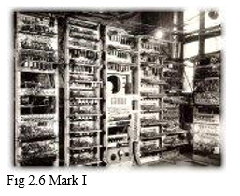
Mark-I
Mark-I (1937 to 1943 AD): With the help of IBM Engineers Prof. Howard Aiken (1900-1973) constructed a computer named Mark-I.
This could multiply numbers in seconds, which was a record at that time. It was first electromagnetic computer that could calculate according to preprogrammed instructions automatically without any need of human intervention.
It was a huge machine and occupied several rooms.
The inside of the computer had the electrical wires that were hundred miles long. Several electromechanical relays & mechanical counters were used for arithmetic calculations.

Slide 22
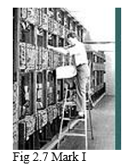
ENIAC
ENIAC: (1946 AD) this was the first electronic Computer developed by a team lead by Prof. Eckert and Mauchy at the University of Pennsylvania in USA.
Electronic Numerical Integrator And Calculator called ENIAC used vacuum tubes as switching devices.
It was having around 18,000 Vacuum tubes, 70000 registers, 10000 capacitors and 600 switches. It used 150,000 watts of electricity & cost $ 400,000. It occupied around 5000 square feet of space. It took around 200 microseconds for addition & 2800 microseconds for multiplication.
US army used it until 1955 to calculate the trajectories of missiles & other mathematical calculations. Instructions were given to the computer by External Plug Boards or switches.

Slide 23
EDVAC
EDVAC (1949 AD): By this time the binary number system was invented.
So now it was simple to store in binary numbers instead of decimal numbers.
Electronic Discrete variable automatic computer known as EDVAC also used the Von Neumann Architecture.
This architecture advocates the concept of pre-stored instructions as programs. With this the operations became faster then before.

Slide 24
EDSAC
EDSAC (1949 AD): Prof. MV Wilkes working at Cambridge University built Electronic Delay And Storage Automatic Computer known as EDSAC.
It used Mercury delay lines for storage. It also used binary number system & Von Neumann Architecture.
This allowed easy implementation of loop structures in programs.

Slide 25
UNIVAC
UNIVAC (1951 AD): Universal Automatic Computer known as UNIVAC was the first commercial computer developed by UNIVAC division of Remington Rand Company.
It was used by General Electric besides other big companies.
Initial applications of computers were in Science & Engineering where the calculations to be done are enormous.

Slide 26
IBM 650
IBM 650 (1955 AD): This computer made IBM as the leader in the field of computers.
Thomas Watson, son of the IBM founder was responsible for introducing this computer with the help of IBM Engineer’s.
IBM 700 Series (1955 AD): IBM 701,IBM 702 and IBM 703 were some of the computers from IBM 700 series. Each was having minor improvements from its predecessor but there was no major change in the design or technology being used.

Slide 27
HISTORY OF COMPUTERS
After this many companies were involved in the manufacturing & development of computing machines. The computers gained the interest of the scientific community as a major tool for solving & performing various applications in different aspects of life.
So there were thousands of models of different computers given by different companies in different countries.
Instead of Discussing Each of them, they had been divided into five generations based on major changes in technology & design of computers.

Slide 28
Classification of computers according to generation
First generation computers
Second generation computers
Third generation computers
Fourth generation computers
Fifth generation computers

Slide 29
First Generation (up to 1954):
All the electronic computers described above are part of the first generation of computers. It started with ENIAC as the first electronic computer. Major characteristics of the computers belonging to first generations were.
The computers used Vacuum Tubes.
The size of the machines was huge.
The speed of processing was very slow.
The space taken was too large.
The computers were very costly.

Slide 30
First Generation (up to 1954):
Difficult to manufacture
Programming was very difficult
It was very difficult to remove the errors.
The computers were having all the components like Input, Output, CPU like the modern day computers
The use of these computers in Industrial or Commercial Sites was very less.
The scope of computers was thought to be in calculating the difficult calculations & doing the complex arithmetic.
Power consumption was more & the computers radiate a lot of heat.
Punched cards were used for Input & Output.
Only Machine level or Assembly language was used.

Slide 31
Second Generation (1955-1964)
IBM 1401(1958), IBM 1620(1960), IBM 7090(1960), IBM 7094(1961), IBM 7094I(1962), IBM 7094 II (1964), Control Data Corporation’s CDC 1604(1961), CDC 3600(1964), Digital data corporation’s PDP 1 (1957), PDP 5 (1963), PDP 8 (1965), UNIVAC 1108(1965) are all examples of the second generation computers.

Slide 32
Characteristics of Second Generation computers
These computers were using transistors for CPU components & ferrite cores for main memory.
As Transistors replaced the Vacuum tubes, so the size decreased as compared to First generation computers.
The performance of the computers increased because transistors consume one tenth of the power as compared to Vacuum tubes & generate less heat.
These used magnetic disks, Magnetic tapes & drums for secondary memory. Memory capacity was up to 100 Kilobytes (1 Kilo Byte= 1024 Bytes).
Floating point arithmetic was widely used in all these machines.
Use of High Level Languages Like FORTRAN, ALGOL & COBOL started in these computers.
The processing speed increased.
These were all batch processing systems.
The Computers were widely used in Science & Engineering Applications apart from many commercial applications.
New Professions like Programmers & system Analysts emerged during this period.
Academic programs in computer science were started during this period.
Concept of operating system started evolving.

Slide 33
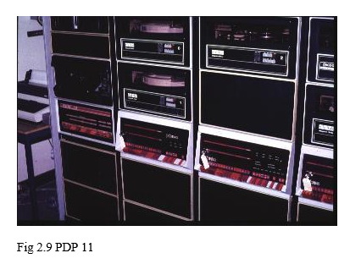
Third Generation Computers (1965-1974)
IBM/370 series (1970), CDC 7600 (1969), PDP 11(1970), ICL-2900 series (1968), Honeywell 6000 series, CYBER-175, STAR-100 are all examples of the third generation of computers.

Slide 34
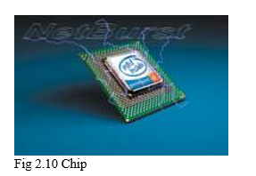
Characteristics of 3rd generation computers
Instead of Transistors ICs (Integrated Circuits) were used for internal operations of CPU. Use of ICs eliminated wired interconnection between components. Initially these were using Small Scale Integrated Chips (SSI) that was having around 10 transistors per chip. In the later years computers were using Medium Scale Integrated Chips (MSI) that were having around 100 transistors per chip.
Semiconductor memories were used. So the memory capacity increased both at primary & secondary memory level. Memory capacity was now up to 100 Mega Bytes (1 Mega Byte = 1024 Kilo Bytes).
Concept of cache memory was also incorporated in third generation of computers.

Slide 35
Characteristics of 3rd generation computers
There was further reduction in size & cost.
The reliability, efficiency & speed increased as compared to its predecessors.
Data Base Management Systems Emerged.
Business applications were now quickly moving towards automation.
Many Interactive Systems became feasible.
Mainframes were the highlights of this generation.
The CPUs were now able to carry 1 million instructions per second.
Multiprocessing, timesharing, multiprogramming systems were introduced.
Concept of networking evolved.

Slide 36
Fourth Generation Computers (1975-2002)
Motorola 68000 series, Intel Series, IBM 3090/600 (1988), IBM ES/9000(1996), VAX 8842(1988), HP 9000 Series, CRAY Y-MP (1988), IBM Deep Blue (1998), IBM PC/XT (1982), IBM PC/AT (1984), IBM PC/AAT (1986) are some of the examples of the Fourth generation computers.

Slide 37
Characteristics of 4th generation computers
There were rapid improvements in the chip technology. In the initial years instead of MSI these computers used Large Scale Integrated chips that were having around 1000 transistors per second. In the late 80s these computers were using Very Large scale integrated chips that were having around 5000 transistors in a chip. The emergence of processor on a single chip has further increased the number of transistors on a single chip to around 500000.
The input & output devices like floppy disk, compact disk, video disk, touch screens, scanners, digital cameras, web cameras, highly improved printers became very common.
The size of the primary memory & secondary memory increased many fold. With improvements in the storage devices now hard disks are most popular media for storage. Now the size of the memory is up to 100 Giga Bytes (1 Giga Byte = 1024 Mega Bytes).
Separate processors are used for different processes like I/O processor, graphics processor etc.
Concept of distributed processing, parallel processing evolved.
Extremely powerful personal computers are now part of every home. Multimedia workstations emerged.

Slide 38
Characteristics of 4th generation computers
The size & cost of the Computers is continuously decreasing. The laptops & handheld computers are the examples of the miniaturization in computer of fourth generations.
Supercomputers are having the speed up to 1 billion instructions per second.
The way we do programming has also changed. In the initial years with the C language programming methodology changed to structured methodology. In the later years with C++ & Java now we are using object-oriented languages. Many interactive languages like Visual Basic, Visual C++, and Visual Age for Java also became popular.

Slide 39
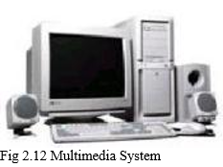
Characteristics of 4th generation computers
Advanced databases incorporating Distributed databases concepts & having user-friendly graphical menus became prevalent.
With advancements in Communication technology & the coming of Internet computers changed the way of life. The way of doing businesses has changed. The concept of digital firm is evolving.
12. With the help of Fiber Optics networks the transmission speeds & quantity of data increased. It became possible to send Audio & Video as data.

Slide 40
Fifth Generation Computers
The Characteristics of these computers will be
Fifth generation computers will use Ultra Large Scale Integration Chips That will have millions of transistors on a single chip.
The speed of the doing computations will be around 1 trillion per second.
The memory size will go up to 100 Terra Bytes (1 Terra Byte = 1024 Giga Byte).
Many of the advanced countries are doing the projects related to this. Sample systems have already been prepared. These Computers will have Artificial Intelligence, so they may also be called as Expert Systems.
These Computers will have intelligence like human beings & will incorporate knowledge-based problem solving skills.

Slide 41
Fifth Generation Computers
The input to these systems can be through speech & graphics. Similarly the output can be taken as speech.
These computers will be able to understand natural languages & will be able to convert one language from another language.
These computers will become more intelligent by time because they will have self-learning techniques.
Genetic Programming, Biotechnology, Biochips, Human like Robots will be the technologies that will evolve.
The computers will be part of mobile phones, handheld devices like watches etc.

Slide 42
Classification of computers according to type
Analog computers
Digital computers
Hybrid computers

Slide 43
Analog computers
The principle on which analog computer work is different from that of digital computers. These work inputs of continuously varying electrical voltages. Data & calculations are also in the form of voltages, current and temperature etc. Voltmeters,
Ammeters are some of the devices that measure these things. The analog computers are faster because they do calculations in parallel but there are chances of error. Many scientific & engineering types of equipment are analog based. You can see many of the equipment in the labs of engineering colleges & universities.

Slide 44
Digital Computers
Digital Computers: The digital computers convert the data into binary digits & then do all the processes. The data is discontinuous. The speed of the digital computers is very fast & increasing further. The accuracy is more than analog computers. There is no branch of life where we are not using digital computers.

Slide 45
Hybrid Computers
Hybrid Computers: Hybrid computers use both analog & digital techniques in optimized way. Many machines that work on some data to be collected from physical quantities work on analog principle but the interface with the operator or the user is through the digital principle.
Most common example can be found in hospitals. Analog part measures the heartbeat and the digital part is used to get the commands from the doctor & interact with the doctor. Hybrid computers are designed for the specific purpose.

Slide 46
Classification of computers according to size
Mainframe computers
Mini computers
Super computers
Workstations
Personal computers
Laptop computers
Handheld computers
Wearable computers

Slide 47
Classification of computers according to size
Mainframe Computers: These computers are used where the transactions to be performed on the same data are large in numbers. Mainframe computers are best in handling the large databases.
These are used in large corporate houses, banks, insurance companies, Govt. offices, defense and airline industry.
The historical mainframe computers used to be of size of an entire room. They need air conditioning & other necessary infrastructure setup to operate smoothly. But the mainframes of today are no more different then a typical workstation. Now it is hard to differentiate between a mainframe computer & other computer based on the size only.

Slide 48
Mainframe cont’d
Mainframe systems are very costly. As per their functionality also they are out of the domain of the common man.
One mainframe system can support many users around the world working on the same data at the same time.
The number of users a particular mainframe can support can vary from few hundred to thousands.
These use concepts of Distributed database management system & parallel processing.
Integrity & security of data are the key features that have to be taken care.

Slide 49
Mainframe cont’d
The main applications that use Mainframe computers are in payroll processing, customer order processing, banking transactions, census operations, airline reservation systems, railway reservation systems, government administration and library management.
IBM 4300 series, IBM 308X series, IBM 3090 series, IBM 9000 series, IBM S/370, IBM S/390 and HP 9000 series are some of the popular mainframes of computer era.

Slide 50
Mini Computers:
Mini Computers: IBM AS/400,VAX 8842,WIPRO 68030, HCL Magnum, IBM 9370 series are some examples of the mini computers.
Minicomputer are also called mid range computers.
The size of the mini computers was small as compared to their contemporaries in early 1970’s.
They fall in between the mainframe & personnel computers with respect to the performance, cost & size.
Most of the minicomputers are designed to act as servers in the labs which are having many terminals connected to each other in the network.
These minicomputers serve the network sharing needs of the user. Now the days the scalable mini computers are being used as web servers with different memory requirements of different users.

Slide 51
Minicomputers cont’d
The cost of the minicomputers is less as compared to the mainframes, but still these are out of the range of common man.
The applications of the mini computers are in the field of file sharing, graphics intensive work, 3D simulations and sophisticated games besides other General-purpose applications.

Slide 52
Super computers
Super Computers: As the name suggests these are the best of all computers in terms of speed & performance.
These computers are very costly & occupy largest of the physical space as compared to others.
The latest Supercomputers can perform around 5 trillion calculations per second that is near impossible for the human mind.
The memory capacity of some of the Supercomputers is also to the tune of many Terra Bytes.
The supercomputers are using the latest techniques like parallel processing, Vector Processing, Pipelining, Distributed Processing etc. CRAY series of supercomputers were very popular.

Slide 53
Super computers cont’d
Some of the initial CRAY computers consisted of around 64 or more number of parallel processors working in the same unit & currently the number of processors in the CRAY computers has gone to thousands.
We can imagine the fast pace & growth of technology in a small span of time
The applications of Supercomputers are in those areas where the amount of data to be processed is huge.
It performs lengthy & complex calculations involving hundreds of parameters in seconds.
Supercomputers are not for the common man & are used for very specific purposes.
So you can see the supercomputers only in Research labs of large corporations or in Govt. offices or in big Universities.

Slide 54
Super computers cont’d
Currently supercomputers are being used in Weather Forecasting, Space Exploration, measuring pollution, Global Information Systems, Biotechnology, Defense, astrophysics, modeling & simulation, designing of aircrafts, Nuclear & atomic research, oil exploration, seismology, fluid dynamics and cryptography.
Still the supercomputers are not able to solve some of the complex problems of the world; the scientists are facing. So the demand for even faster computers is growing.
The companies are involved in these projects. These companies are spending millions of dollars on the research. IBM is the leader in Supercomputers. Hopefully in next five years we will have supercomputer that can perform 100 trillion instructions per second.

Slide 55
Super computers cont’d
The research is now being done in complex areas because of the tools available for analyzing & calculating the data with the help of supercomputers.
The calculations that may have taken 20 years to perform by hand can now be done in seconds.
It is due to this that scientists are now able to do the research at finer levels.
Now it has become possible to collect data about all the Genes of Humans that consists of millions of pages of information.
The atomic explosions that were being carried out to develop the military strength of a country are now simulated on Supercomputers.

Slide 56
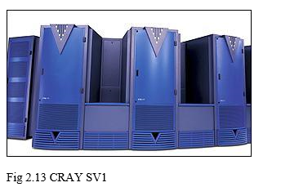
Super computers cont’d
Some of the best supercomputers of the world with the time the capacity & power of supercomputers is increasing beyond our imagination.
Some of the best supercomputers are being developed in Linux that include more than 600 IBM xSeries eServers running Linux and Myricom's Myrinet cluster interconnect network.
Deep Blue, CRAY1, CRAYT3E and CRAY SV1 are some of the supercomputers in the world.

Slide 57
workstations
Workstations are often designed with specific applications in mind. The companies are providing scalable architecture workstations for fulfilling the specific demands of the customers.
If a civil Engineer wants a workstation for designing with the latest software using high end graphics & 3D simulation then the workstation will have the powerful graphic processors besides other configuration matching the customer needs.

Slide 58
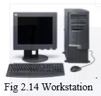
Workstations cont’d
The workstations are always more powerful then a typical computer in terms of storage capacity and processing speed. Some of the personnel computers of today are more powerful than the older workstations. This demonstrates the changing requirements of different levels of society in terms of computer memory & speed.

Slide 59
Personal computers
When anyone uses the term personal computer, microcomputer or desktop computer that means the small computers that are used in offices, homes or classrooms.
These are called personal computers because they fulfill the needs & requirements of an individual. These are called desktop because they can be fitted on to a single desktop.
These are called microcomputer because they generally have a single microprocessor chip that performs all the functions of a CPU.
These systems come in various sizes, shapes & color. Different system have different configuration depending upon the individual needs

Slide 60
Personal computers cont’d
The applications of PCs are in word processing, Accounting, Education, Database management, managing small businesses, Health, Painting, communication and playing games etc.
The term started with IBM shipping its product in 1981 named as PC. So some associate Personal computers with IBM till now. But after that everyone cloned or shared the concept of IBM & made their products.
The cost of the personal computers is very low & is going low with passing of every year. These systems are now easily affordable by the masses.
Users can choose from the different models from different companies.

Slide 61
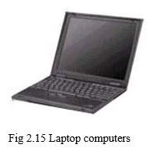
Laptop computer
These are similar to Personal computers in terms of performance but they differ only in their size.
The power requirements of a laptop computers are very less so they can work on small batteries for a longer period.
These are also called portable computers due to their small size.
These can fit in to a small bag & can be carried with while traveling.
These are very useful for the managers of the multinational companies and for the marketing persons because they need to travel to different places most of the time.
The cost of the laptops are higher then a PC but are still in the affordable range. These will further go down in the near future.

Slide 62
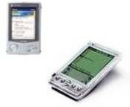
Handheld computers
These are the computers that are of very small size & can be carried in your pocket. These are called handheld computers. Personal Digital assistants, Mobile phones with Internet facility, High-end calculators, palmtop computers and personal organizer are all under this category.
These computers may not have the power equivalent to a PC but these are very handy for performing small tasks when you are on the move.
These devices have a fair amount of memory and also good processing speed.
These systems are evolving very fast & everyone will be carrying a handheld computer in the very near future.
The main works which are done on these devices are to manage the addresses & contact information, send Fax & E-Mail, read & move data, word processing tasks, Schedule management, preparing a presentation, monitoring & communication.

Slide 63
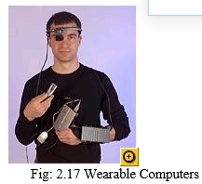
Wearable computers
It is a computer that is part of the user always even while walking or doing any other activity.
These computers can be part of your jacket or glasses or belt or anything else that you wear.
Several wearable computers are already in the market. Wristwatch computers, Pocket computers with display in the glasses are already popular. After ten years we all will be wearing the computers as part of our dress code.

Slide 64
Social implication of computers on society
Positive
It facilitates business process and other activities
We can store much more information on a computer which makes it easy to handle the information for business applications
We can perform multitasking an d multiprocessing capabilities of data
It is very easy to access and use data for business application
We can store documents secretly on computer system
It gives error free result so that we can use it for research, engineering work and other areas.
It can be used for various purposes like education, business, industries etc.
It is used for communication system also. For example, use of internet, email and internet phone system
It helps to automate the office and business process
It provides greater access to computerized resources using internet and computer based encyclopedia

Slide 65
Social implication of computers on society
Negative
It is an expensive system so people may not be able to afford it and use this system that creates digital divide on society
It may increase unemployment. A task that can be done by several people is accomplished by one computer
There are chances of stealing data which destroys data. This may be through hacking
It requires timely updates because it is a fast changing technology
Illiteracy of computers causes suffering while using computerized systems
It facilitates computer crime and cyber theft

Slide 66
Importance of Computers
They are used for education purposes
They are used in hospitals to archive patient records and treatment received, it allows monitoring of heart rates and blood pressure of a person
They are used for surfing the internet.
They are used for communication between people in all countries of the world. This is through social media
Computers are used to run businesses such as conducting online sales, transferring funds between accounts etc.
Computers are also used in transportation in booking travel tickets, determine take-off and direction of aircraft.

Slide 67
Importance of computers
Industries rely on the operation of machines to ensure high level of quality
Computers are used for entertainment
Computers are used in engineering by helping in advanced engineering drawing such as design of buildings, structures, ships, planes, city, planning and design through 2D and 3D
Computers are used in the military to control computerized systems that control missile launches, military communications, military planning operations and smart weapons
Computers are used in various protection systems such as the use of facial recognition and fingerprint. This has reduced the possibility of identity fraud
Computers are used in automation systems that are concerned with the manufacture of automated robots

Slide 68
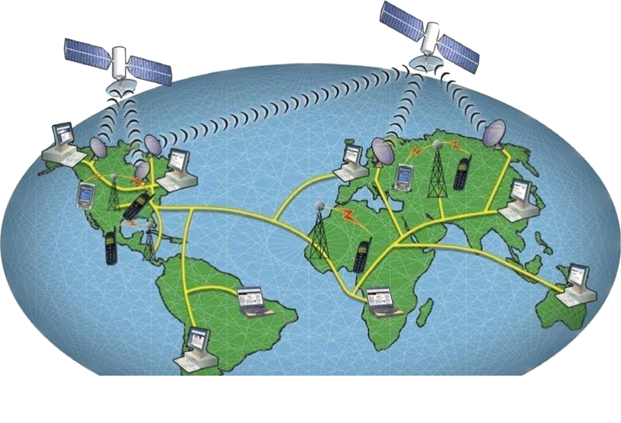
Internet
Internet is a collection of networks that connect millions of computers.
Internet is World Wide network of computers making information available to everyone.

Slide 69
Internet
These Computers are connected through
Telephone lines: telephone lines transmit signals from one place to another and the signals are translated by modems.
Cables in the ground: the use of optical cables which are laid in the ground then they connect different devices. optical cables transmit signals with a speed of light.(3x10⁸m/s)
Satellite in space: satellite dishes capture signals from satellites in space and transmits them to their required destinations.

Slide 70
Modem
A modem is used to translate information transferred through telephone lines or cable and from satellite dishes.
The term stands for modulate and demodulate which changes the signal from digital, which computers use, to analog, which telephones use and then back again.
A high speed connection also requires a modem but because the information is transferred digitally it isn't required to change the signal from digital to analog but is used to create the connection between your computer and the computer you are connecting with.
Protocol
Set of rules that determine how data are exchanged between different computers.

Slide 71
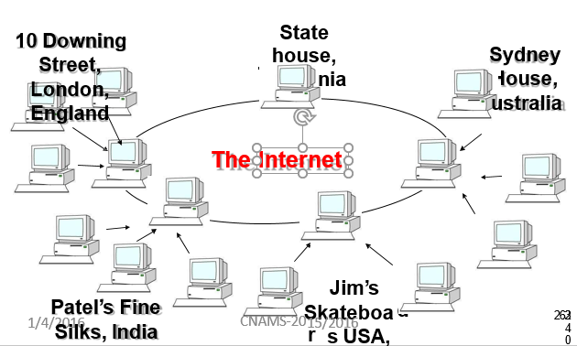

Slide 72
Advantages of using the internet
Sharing files
Communication
Shopping
Learning
Entertainment
Sharing other devices (printers)
Central administration of all devices.
Supporting network applications like: E-mail, Database services.

Slide 73
Dangers of using internet
Virus threat - Today, Internet is the most popular source of spreading viruses. Most of the viruses transfer from one computer to another through e-mail or when information is downloaded on the Internet. These viruses create different problems in your computer. For example, they can affect the performance of your computer and damage valuable data and software stored in your computer.
Security Problems- The valuable websites can be damaged by hackers and your valuable data may be deleted. Similarly, confidential data may be accessed by unauthorized persons.

Slide 74
Cont’d
Immorality- Some websites contain immoral materials in form of text, pictures or movies etc. These websites damage the character of new generation.
Filtration of Information - When a keyword is given to a search engine to search information of a specific topic, a large number of related links a displayed. In this case, it becomes difficult to filter out the required information.

Slide 75
Cont’d
Accuracy of Information - A lot of information about a particular topic is stored on the websites. Some information may be incorrect or not authentic. So, it becomes difficult to select the correct information. Sometimes you may be confused.
Wastage of times – a lot of time is wasted during the collection of data from the internet. Some people waste a lot of time to chat or play games. At home or office, most of the people use internet without any positive impact.

Slide 76
Cont’d
Language problem- Most of the information on the internet is available in English language. So, some people can not make use of the internet facility.

Slide 77
Internet services
Internet banking
E-Government
E-Learning
E-Commerce/E-Business
E-Marketing
Voice Over Internet Protocol (VoIP)
E-Mail
Instant Messaging
Video Conferencing

Slide 78
Internet banking
Internet banking is the electronic banking via the internet.
Internet banking is the system where customers can view their account details, pay bills and transfer money by means of the internet.

Slide 79
Advantages of internet banking
It is fast
It simplifies banking activities because users can have access to their money anywhere in the world.
Disadvantages
Theft of money due to hacking.
It is expensive to run and difficult to manage.

Slide 80
E-Governance
E-Governance is the application of Information and Communication Technology (ICT) for delivering government services, exchange of information, communication, transactions, integration of various stand-alone systems and services between Government-to-Citizens (G2C), Government-to-Business(G2B),Government-to-Government( G2G) as well as back office processes and interactions within the entire government frame work.
Through the e-Governance, the government services will be made available to the citizens in a convenient, efficient and transparent manner.

Slide 81
Advantages of E-Governance
It promotes transparency to the government sector and encourages democratization.
It enforces accountability.
It improves speed, efficiency and convenience.
It helps to improve public services.
Disadvantages
It is expensive to run and manage.
It is difficult to implement.

Slide 82
E-Learning
E-learning is the computer and network-enabled transfer of skills and knowledge. E-learning applications and processes include Web-based learning, computer-based learning, virtual education opportunities and digital collaboration.
Content is delivered via the Internet, intranet/extranet, audio or video tape, satellite TV, and CD-ROM.
It can be self-paced or instructor-led and includes media in the form of text, image, animation, streaming video and audio.

Slide 83
Advantages of E-Learning
It facilitates distance learning
It simplifies access to learning materials such as books, journals and articles.
A tutor can teach many students from different locations at once.
Disadvantages
Poor or no face to face communication between teacher and students.
It is easy for students to cheat.
It requires expensive facilities and technology.

Slide 84
E-Commerce
E-commerce is the use of internet to engage in the exchange, including buying and selling, of products and services requiring transportation, either physically or digitally, from location to location.
OR
Is the process of buying and selling goods or services across the internet
The following are key stages of E-commerce processes
Buyer finds seller
Selection of goods
Negotiation
Sale
Payment
Delivery
/P^{4/}o²s⁰t¹- sale activity

Slide 85
Advantages of E-Commerce
It simplifies buying and selling processes.
It promotes customer relations through storing customer information and trace customer buying information.
It promotes start-up, small and medium sized enterprises to reach the global market.
Disadvantages
Computer hacking
Computer theft from fake websites that pretend to sell products while they don’t.

Slide 86
Voice Over the Internet Protocol (VoIP)
This is a technology that allows users to make voice calls using a broadband internet connection instead of a regular (or analog) phone line.
Advantages of VoIP
It is cheaper to make international calls than the traditional phone.

Slide 87
Disadvantages of VoIP
Not all VoIP services connect directly to the emergency services through 9-1-1.
VoIP providers may or may not offer directory assistance.
Some VoIP services don’t work when there is power outages.

Slide 88
E-Mail
Electronic mail, commonly known as email or e-mail, is a method of exchanging digital messages from an author to one or more recipients.
Modern email operates across the Internet or other computer networks.
Some early email systems required that the author and the recipient both be online at the same time, in common with instant messaging.
Email is a messaging system which can be used to transmit text messages and file attachments. Attachments can be word processed documents, graphics, video and sound.

Slide 89
E-mail address
An E-mail address is made up of certain components that help to route it the proper recipient just like postal address on the envelope.
E.g kasozi@gmail.com
Kasozi is the username.
@ is a sign that serves as a divider between e-mail sections.
Gmail.com is the domain name which is the name of the user’s email system or location.

Slide 90
The Advantages of E-mail
It's fast - Messages can be sent anywhere around the world in an instant
It's cheap - Transmission usually costs nothing, or at the most, very little
It's simple - Easy to use, after initial set-up
It's efficient - Sending to a group can be done in one step
It's versatile - Pictures, power points or other files can be sent too

Slide 91
Disadvantages of E-mail
Email can become time consuming for answering complicated questions and misunderstandings can arise because cultural differences in the interpretation of certain words. The telephone is much better for providing detailed answers or if you feel that the question is not absolutely clear.
Email can compromise the security of an organization because sensitive information can be easily distributed accidentally or deliberately. Email should be entrusted to well trained and trusted staff members.
Email can become impersonal or misunderstood.

Slide 92
Application of E-Mail in Daily life
Using email for business
Email is a powerful, low-cost communications tool that businesses are using to market their goods, provide better customer service and work more efficiently.
Marketing by email
Email can provide a cost-effective way of marketing. Customers can be targeted cheaply and instantly and, unlike other forms of marketing, emails can be easily and quickly forwarded to colleagues or friends. Encouraging the recipients of marketing emails to forward them on is known as viral marketing.
Improving customer service
Email can be used to improve customer service. Encouraging customers to contact you by email can benefit both parties - they do not have to hang on the phone or make contact in working hours and you do not have to respond immediately, which can free up staff from answering the phone.
Communication with shareholders
Companies can send information to shareholders using email and other kinds of electronic communication, although they have to send information on paper if shareholders ask for it.

Slide 93
Videoconferencing
Videoconferencing is a set of telecommunication technologies which allow two or more locations to interact via two-way video and audio transmissions simultaneously.

Slide 94
Assignment 2
USB
OS
PDF
CRT
LCD
GIGO
WYIWYG
BIOS
UPS
ALU
CPU
VDU
HDD
RAM
ROM
CD
CD-R
CD-RW
DVD

